Slide 1
Gen AI
Chat Gpt
Why are calling this AI tool as Gen AI, Generative AI?
How is ChatGPT able to give you an Answer to your questions/prompts?

Slide 2
Gen AI
K nn
K Nearest Neighours
Vamsi
Male
Commando
Boxer
123
King
What is the Job of Kavita?
Kavita
(0,1,2)
Chiranjeevi
Queen
(0,2,2)
Nurse
(0,3,2)
Airhostess
What car does Vamsi Drive?
Female
The car that Vamsi Drives is Boxer
Vector Databases
Hallucination?

Slide 3
Gen AI

Slide 4
Gen AI

Slide 5
Gen AI

Slide 6
9 pm EST, Monday 11 November 2024 Salary Experience Machine Learning Slides

Slide 7

Linear Regression
Learn easy. Enjoy Easy. Expertise easy
Notes:
Statistics: is that branch of mathematics which deals with gathering, interpreting, and organizing the information or data.
Descriptive statistics uses the data to provide descriptions of the population, either through numerical calculations or graphs or tables.
Inferential statistics makes inferences and predictions about a population based on a sample of data taken from the population in question.

Slide 8
Predict Applicants Salary -
Using Linear Regression Algorithm

Slide 9
Loan Applications – Let us Predict “salary” when the input is “years of experience”
You distribute Loans. When you distribute loans, Salary of a person or Income of an employee is an important component.
Applicants will fill in their details of Income , they will also submit tax returns etc.
However you want to build a Machine Learning model that will Predict salary for years experience
What will be Salary if the Experience is 15?
Notes:
Salary - Dependent and Years of Experience - Independent. The dataset has two columns — number of years of work experience, and the salary for that experience. Our goal is to build a model which will learn on this dataset and will be able to predict the salary for a given number of years of experience.

Slide 10
Linear Regression
Linear regression models are used to show or predict the relationship between two variables or factors. The factor that is being predicted (the factor that the equation solves for) is called the dependent variable. The factors that are used to predict the value of the dependent variable are called the independent variables.
In linear regression, each observation consists of two values. One value is for the dependent variable and one value is for the independent variable. In this simple model, a straight line approximates the relationship between the dependent variable and the independent variable.
When two or more independent variables are used in regression analysis, the model is no longer a simple linear one. This is known as multiple regression.
Notes:
Salary - Dependent and Years of Experience - Independent. The dataset has two columns — number of years of work experience, and the salary for that experience. Our goal is to build a model which will learn on this dataset and will be able to predict the salary for a given number of years of experience.

Slide 11
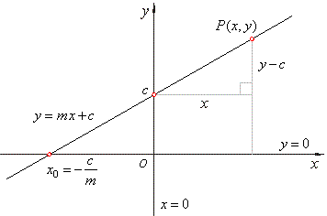
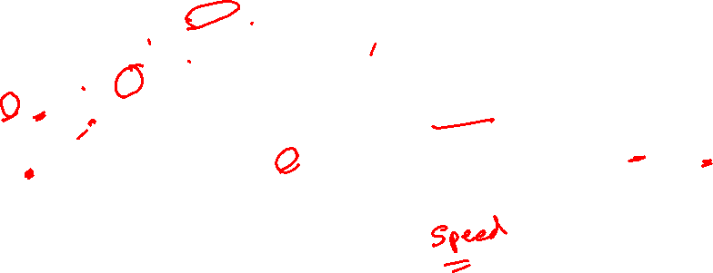
Linear Regression - equation
y = mx + c
The slope of the line is m, and c is the intercept (the value of y when x = 0).
Notes:
https://towardsdatascience.com/linear-regression-using-gradient-descent-97a6c8700931
Linear Regression
In statistics, linear regression is a linear approach to modelling the relationship between a dependent variable and one or more independent variables. Let X be the independent variable and Y be the dependent variable. We will define a linear relationship between these two variables as follows:y = mx + c
This is the equation for a line that you studied in high school. m is the slope of the line and c is the y intercept. Today we will use this equation to train our model with a given dataset and predict the value of Y for any given value of X. Our challenge today is to determine the value of m and c, such that the line corresponding to those values is the best fitting line or gives the minimum error.
Loss Function
The loss is the error in our predicted value of m and c. Our goal is to minimize this error to obtain the most accurate value of m and c. We will use the Mean Squared Error function to calculate the loss. There are three steps in this function:
Find the difference between the actual y and predicted y value(y = mx + c), for a given x.
Square this difference.
Find the mean of the squares for every value in X.

Slide 12
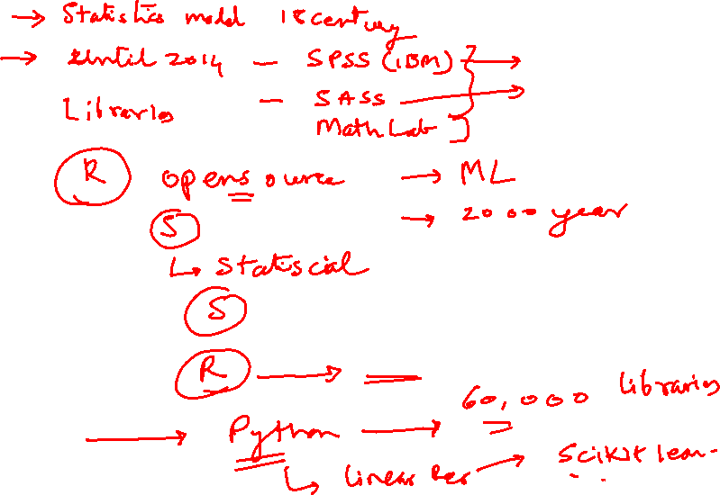

Slide 15
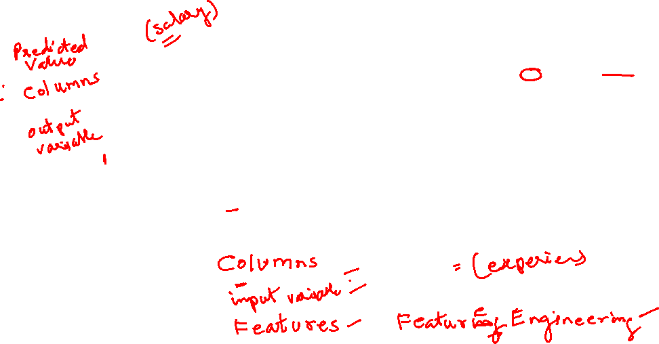
Linear Regression – Independent and Dependent Variables
Y
Line
Dependent Variable
X
Independent Variable
Notes:
Independent

Slide 16
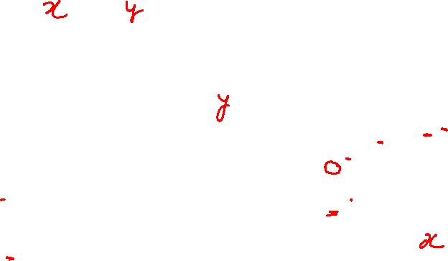
Linear Regression – Independent and Dependent Variables
Notes:
Independent

Slide 17


Positive Relation
Y
Dependent Variable
+ve
X

Slide 18


Negative Relation
Y
Dependent Variable
-ve
X
Independent Variable

Slide 19
Linear Regression
Y
Line of Linear Regression
Dependent Variable
X
Independent Variable
Notes:
Linear regression attempts to model the relationship between two variables by fitting a linear equation to observed data. ... A linear regression line has an equation of the form Y = a + bX, where X is the explanatory variable and Y is the dependent variable

Slide 20

DatA Points - Observations
Y
Dependent Variable
Observation
X
Independent Variable

Slide 21








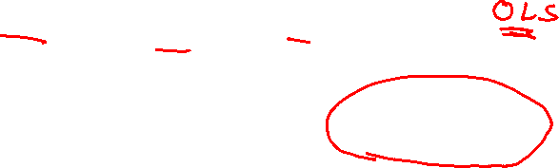
Plotting the best Fit Line – Using the Least Square Method (ordinary least squares)
Y
Regression Line
Least Square Method
Dependent Variable
X
Independent Variable

Slide 22








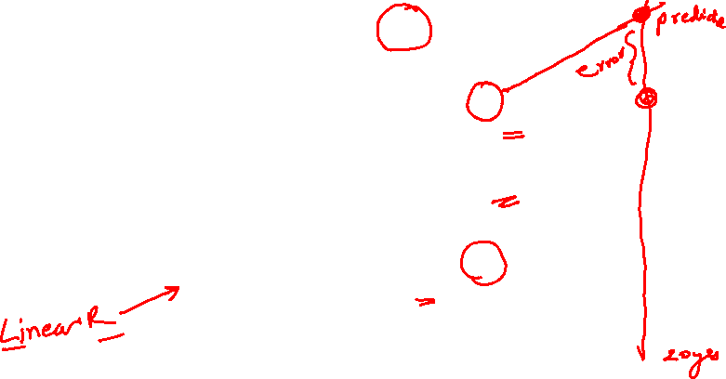
Error: Estimated Value - Predicted Value
Y
error
Dependent Variable
Estimated Value
error
Actual Value
X
Independent Variable

Slide 23
Minimize the error
Y
Dependent Variable
Minimize the error
X
Independent Variable

Slide 24
How to Create Linear Regression – equation to Predict Salary
y = mx + c
The slope of the line is m, and c is the intercept (the value of y when x = 0).
Notes:
https://towardsdatascience.com/linear-regression-using-gradient-descent-97a6c8700931
Linear Regression
In statistics, linear regression is a linear approach to modelling the relationship between a dependent variable and one or more independent variables. Let X be the independent variable and Y be the dependent variable. We will define a linear relationship between these two variables as follows:y = mx + c
This is the equation for a line that you studied in high school. m is the slope of the line and c is the y intercept. Today we will use this equation to train our model with a given dataset and predict the value of Y for any given value of X. Our challenge today is to determine the value of m and c, such that the line corresponding to those values is the best fitting line or gives the minimum error.
Loss Function
The loss is the error in our predicted value of m and c. Our goal is to minimize this error to obtain the most accurate value of m and c. We will use the Mean Squared Error function to calculate the loss. There are three steps in this function:
Find the difference between the actual y and predicted y value(y = mx + c), for a given x.
Square this difference.
Find the mean of the squares for every value in X.

Slide 25
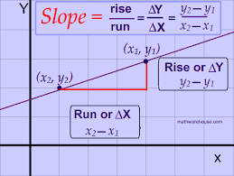
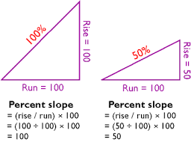
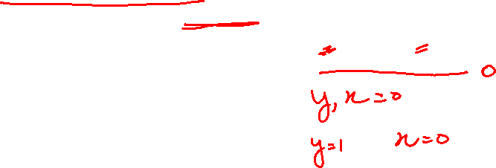
Calculating THE Slope

Slide 26
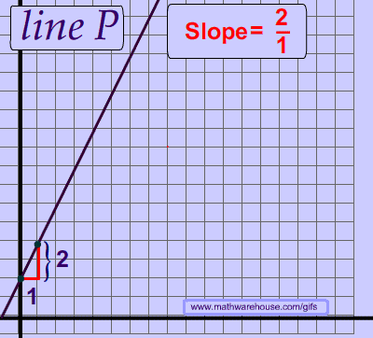
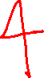
How a Slope will Draw the Line

Slide 27
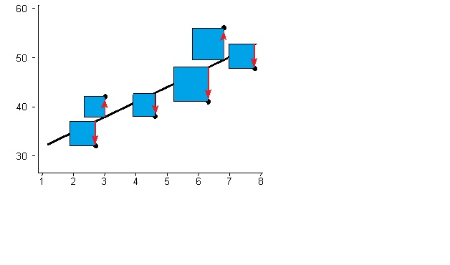
Least Squares Regression Line
The Least Squares Regression Line is the line that makes the vertical distance from the data points to the regression line as small as possible. It’s called a “least squares” because the best line of fit is one that minimizes the variance (the sum of squares of the errors).
This can be a bit hard to visualize but the main point is you are aiming to find the equation that fits the points as closely as possible.

Slide 28
Predict Salary
Using linear regression equation

Slide 29
Predict the Salary when input is Experience
Y
X Independent
Variable
Exp
Y Dependent
Variable
$Salary
Dependent
Variable
5
4
3
2
1
0 1 2 3 4 5 6
X
Independent Variable

Slide 30
Predict the Salary when input is Experience
X Independent
Variable
Exp
Y Dependent
Variable
$Salary
Y
Dependent Variable
X
Independent Variable

Slide 31
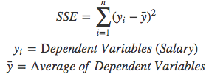
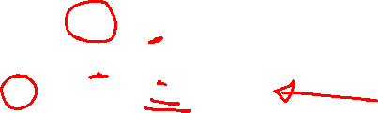
Sum of Squared Errors
In order to fit the best intercept line between the points in the above scatter plots, we use a metric called “Sum of Squared Errors” (SSE) and compare the lines to find out the best fit by reducing errors. The errors are sum difference between actual value and predicted value.
To find the errors for each dependent value, we need to use the formula below.

Slide 32
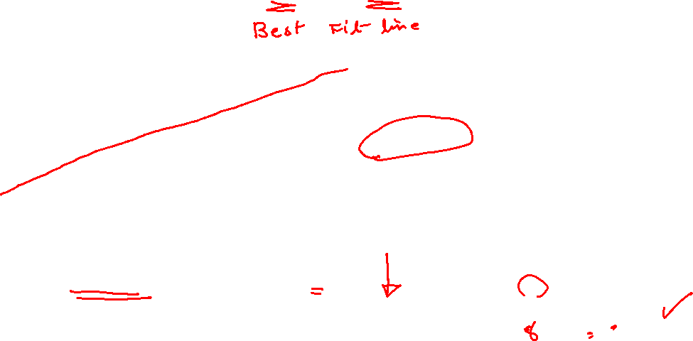
Mean Line or the worst Fit Line
Y
Dependent Variable
45.4-mean line
X
Independent Variable
We find the “Sum of Squared Errors” (SSE) for a Mean line

Slide 33
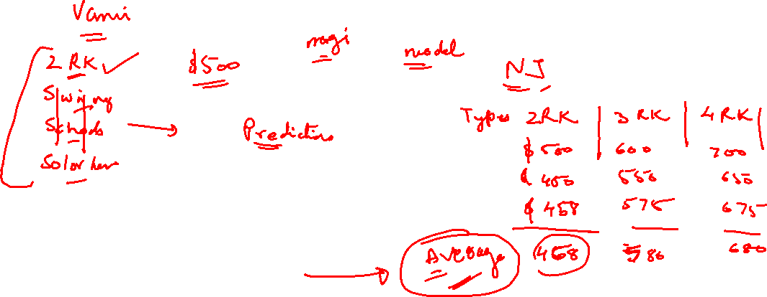

Slide 34
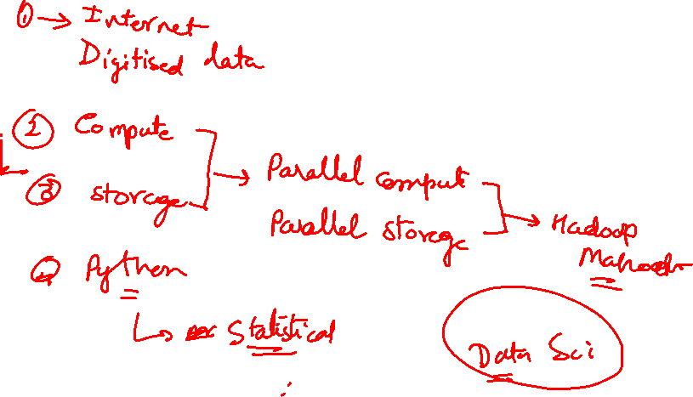

Slide 36
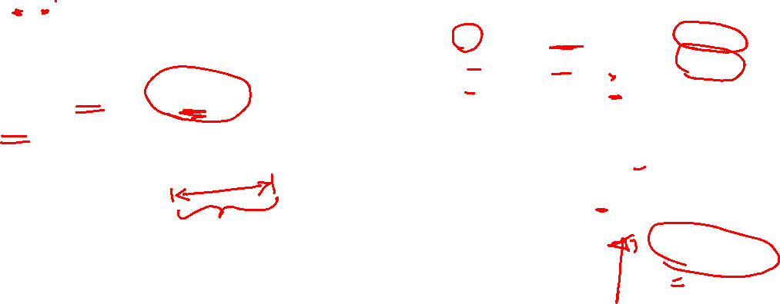
Sum of Squared Errors
The sum of squared errors SSE output is 5226.22
when the line is mean line.

Slide 37
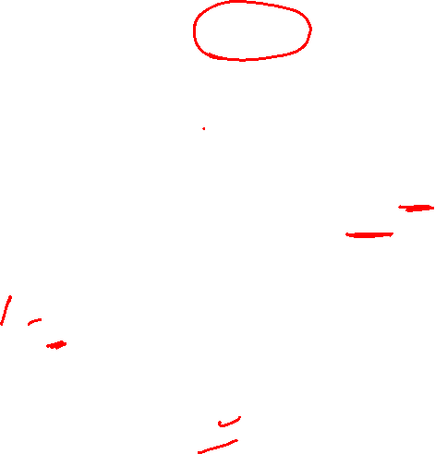
Find ThE BesT fit of Line
The mean line gave us SSE 5226.22
We have to find a line that will bring down the SSE value.
We need to find the best fit of line intercept, we need to apply a linear regression model to reduce the SSE value at minimum as possible. To get the best fit line we need to identify a slope intercept, we use the equation
y=mx+b
m is the slope
b is intercept
x → independent variables
y → dependent variables

Slide 38
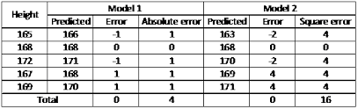
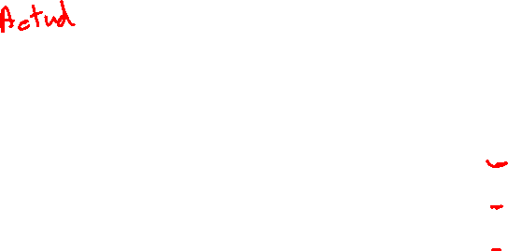

Slide 39
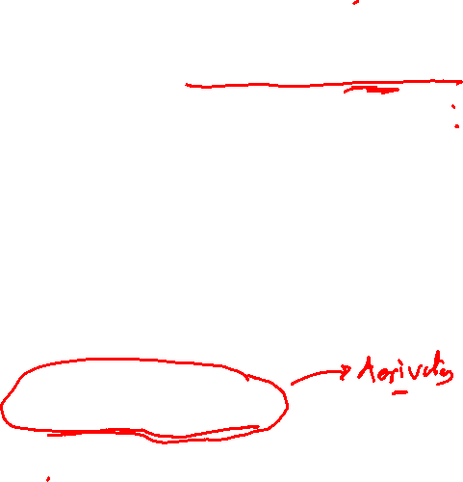
2 Methods to find the BesT fit of Line
1. Ordinary Least Square method :will work for both univariate dataset and multi-variate dataset.
Univariate dataset which is single independent variables and single dependent variables.
Multi-variate dataset contains a single independent variables set and multiple dependent variables sets
2. Gradient Descent machine learning algorithm is applied on Multi-variate datasets

Slide 40
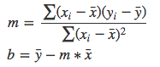
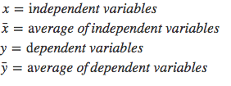
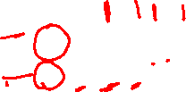
Ordinary Least Squares (OLS) Method
We will use Ordinary Least Squares method to find the best line intercept (b) slope (m)
y=mx+b
To use OLS method, we apply the below formula to find the equation

Slide 41
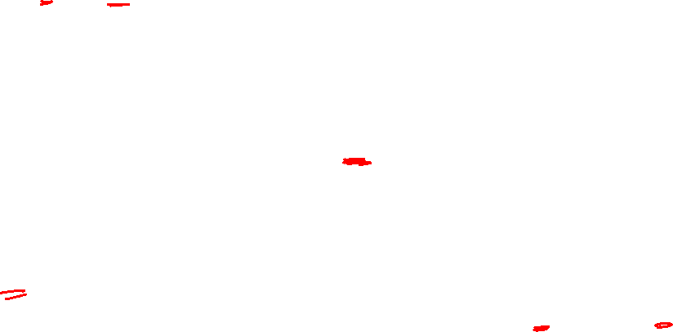
Mean of the Data Points
7.56-mean line
Y
Dependent Variable
45.4-mean line
X
Independent Variable
We find the “Sum of Squared Errors” (SSE) for a Mean line

Slide 42
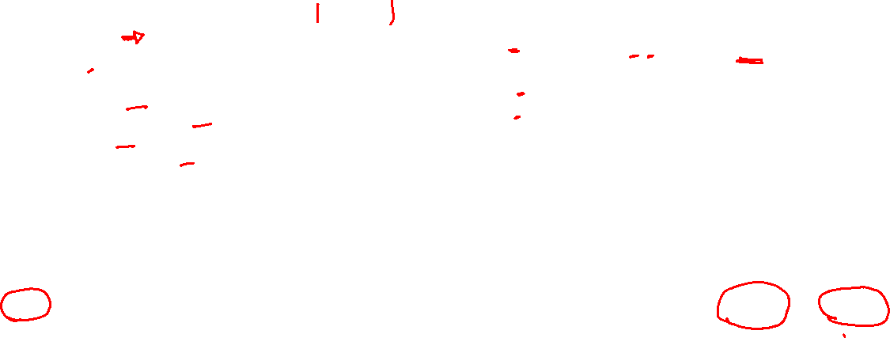
Ordinary Least Squares (OLS) Method
Calculate Slope:
m = 1037.8 / 216.19
m = 4.80

Slide 43
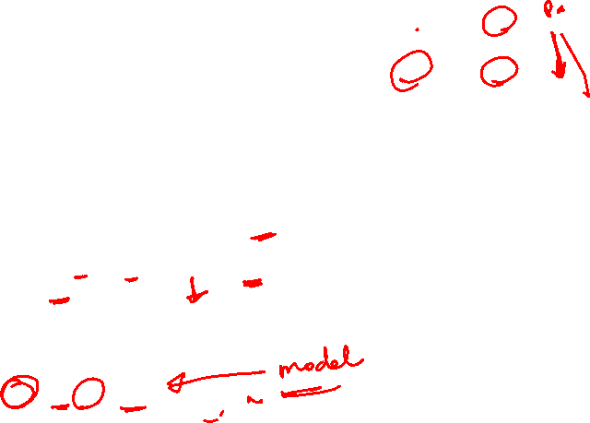
Ordinary Least Squares (OLS) Method
Calculate the intercept(b)
b = 45.44 - 4.80 * 7.56 = 9.15
b=9.15
Hence:
y = mx + b
→ 4.80x + 9.15
y = 4.80x + 9.15

Slide 44
Best Fit Line using (OLS) Method
OLS Method:
m = 1037.8 / 216.19
m = 4.80
b = 45.44 - 4.80 * 7.56 = 9.15
Hence, y = mx + b → 4.80x + 9.15
y = 4.80x + 9.15
Excel:
y = 4.79x + 9.18

Slide 45
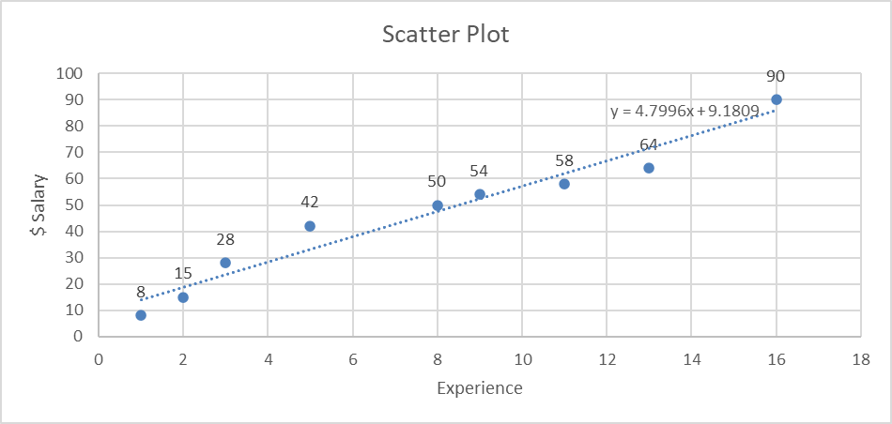
Best Fit Line using (OLS) Method
Excel:
y = 4.79x + 9.18
OLS Method:
y = 4.80x + 9.15

Slide 46
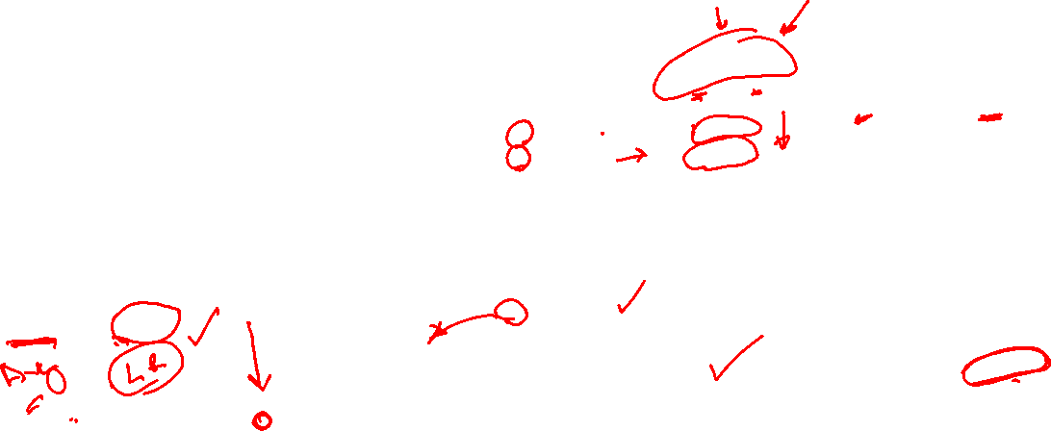
Sum of Squared Errors – Predicted Output
The sum of squared errors SSE output is 245.38
for the predicted line.
Now Sum of Squared Error got reduced significantly from 5226.19 to 245.38.

Slide 47
Gradient Descent
Gradient Descent is an optimization algorithm used for minimizing the cost function in various machine learning algorithms. It is basically used for updating the parameters of the learning model.

Slide 48
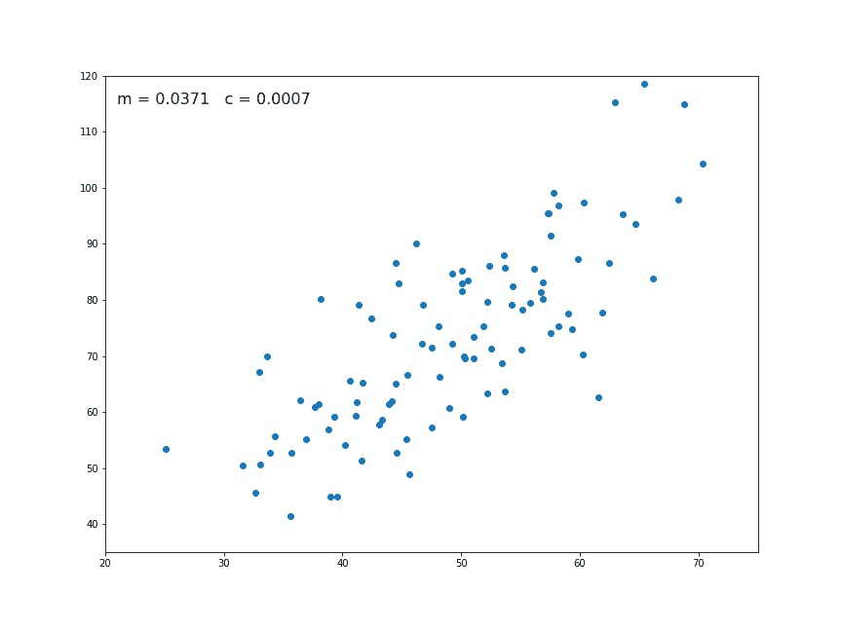
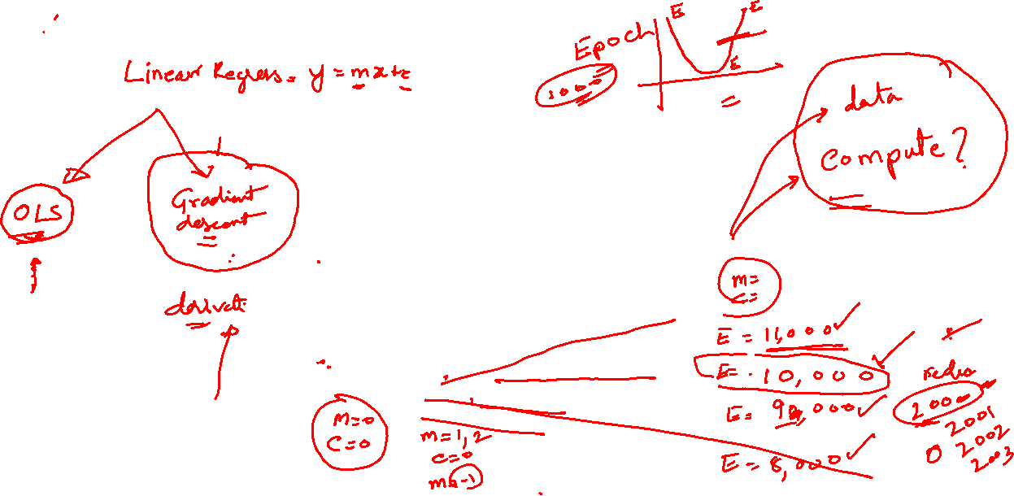
Finding the best fit line: using Gradient Descent, Minimizing the error
Notes:
https://towardsdatascience.com/linear-regression-using-gradient-descent-97a6c8700931
Finding the Best Fit Line
What is cost function in gradient descent?
Minimizing the cost function:
Gradient descent
Gradient descent enables a model to learn the gradient or direction that the model should take in order to reduce errors (differences between actual y and predicted y)

Slide 49
Finding the best fit line: using Gradient Descent, Minimizing the error
Notes:
https://towardsdatascience.com/linear-regression-using-gradient-descent-97a6c8700931
Finding the Best Fit Line
What is cost function in gradient descent?
Minimizing the cost function:
Gradient descent
Gradient descent enables a model to learn the gradient or direction that the model should take in order to reduce errors (differences between actual y and predicted y)

Slide 50
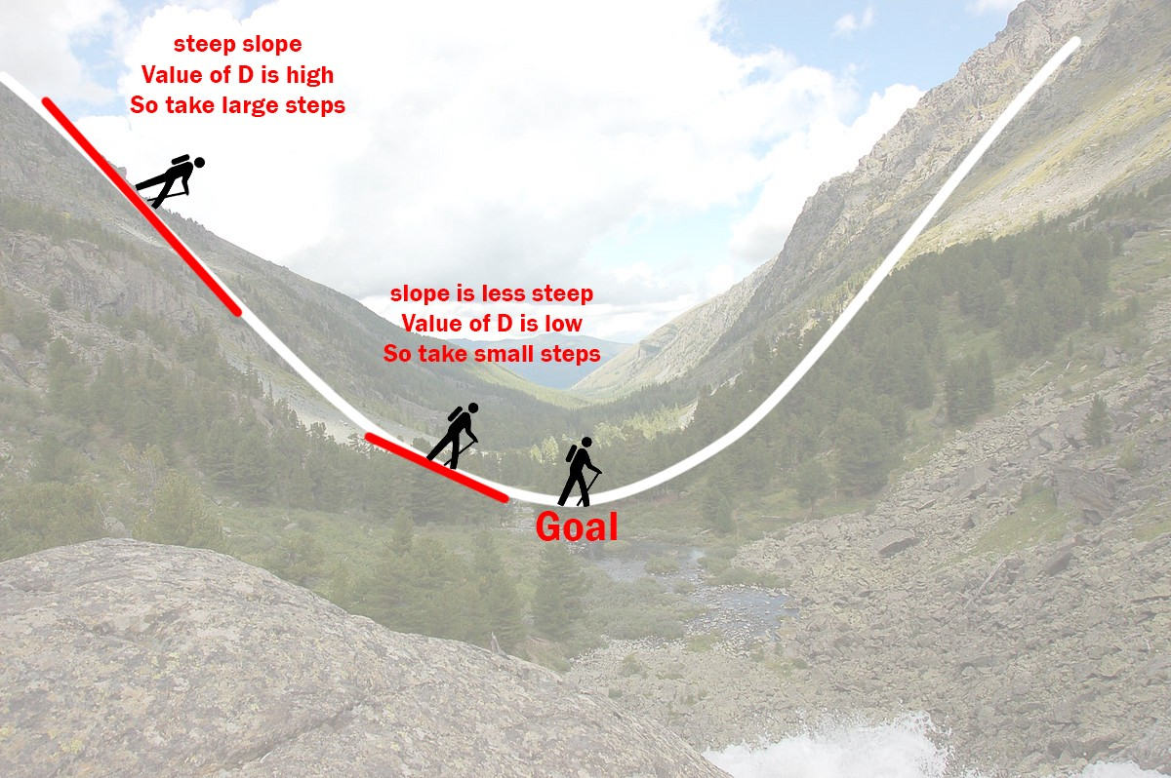
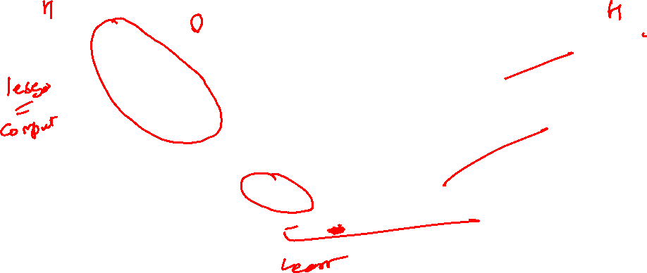
How Gradient Descent works
Notes:
The Gradient Descent Algorithm
Gradient descent is an iterative optimization algorithm to find the minimum of a function. Here that function is our Loss Function.
Understanding Gradient Descent
Imagine a valley and a person with no sense of direction who wants to get to the bottom of the valley. He goes down the slope and takes large steps when the slope is steep and small steps when the slope is less steep. He decides his next position based on his current position and stops when he gets to the bottom of the valley which was his goal.
Let’s try applying gradient descent to m and c and approach it step by step:
Initially let m = 0 and c = 0. Let L be our learning rate. This controls how much the value of m changes with each step. L could be a small value like 0.0001 for good accuracy.
Calculate the partial derivative of the loss function with respect to m, and plug in the current values of x, y, m and c in it to obtain the derivative value D.

Slide 51
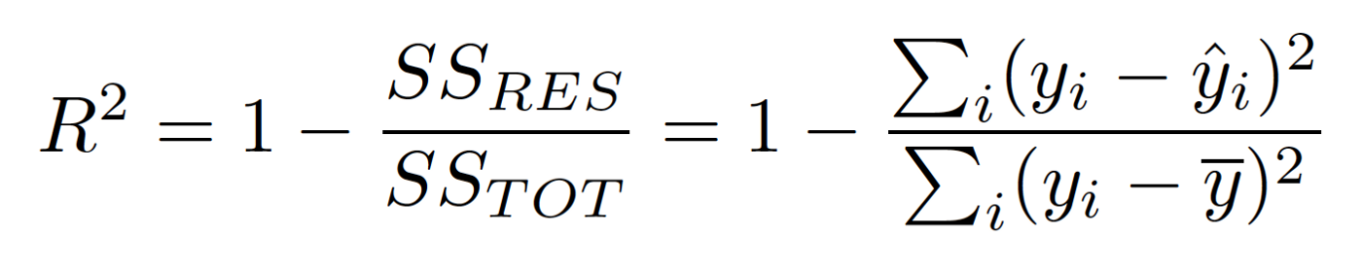

R Square
(SSres) Residual sum of squared errors of our regression model
actual y value = 5 but we had predicted y^ would be 6 then the residual squared error 1
and we would add that to the rest of the residual squared errors (SSres) for the model.
(SStot) Total sum of squared errors - This is comparing the actual y values to our baseline model the mean y.
_
Notes:
https://medium.com/@erika.dauria/looking-at-r-squared-721252709098
It is interesting to note that the R-Squared formula does not make use of any independent variables.
https://www.machinelearningplus.com/machine-learning/complete-introduction-linear-regression-r/

Slide 52
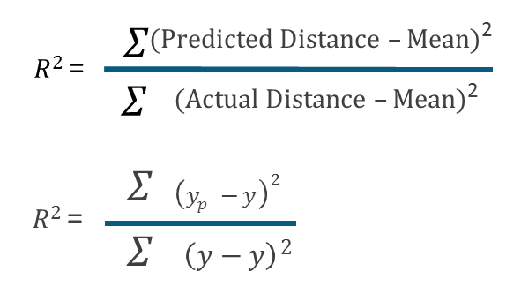
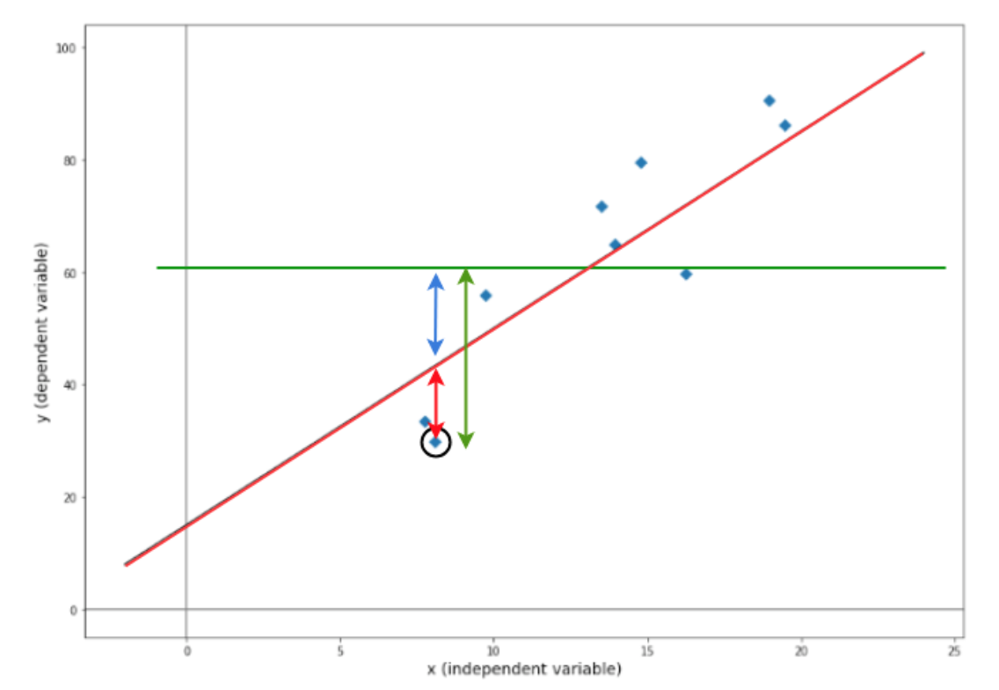
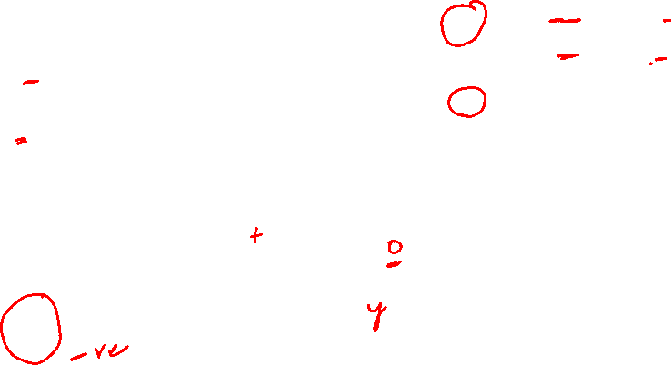
_
Y Mean
Baseline Model
Worst Model
Mean
_
^
Y Predicted
Y
Y
Actual
^
Y
Y

Slide 53
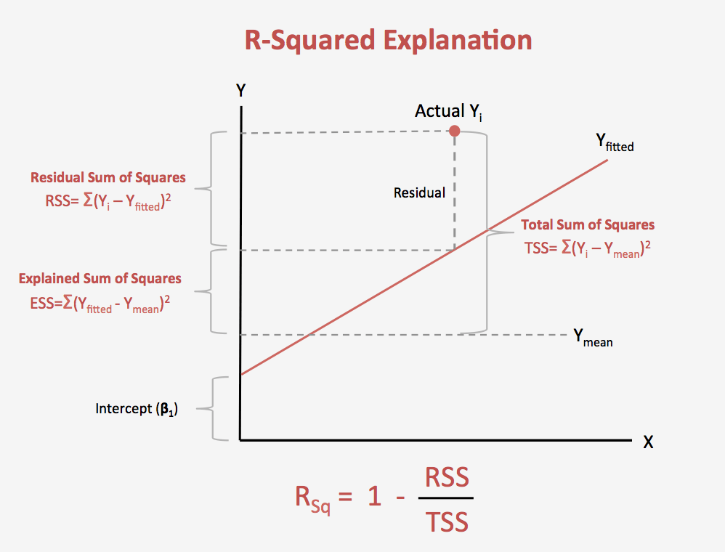
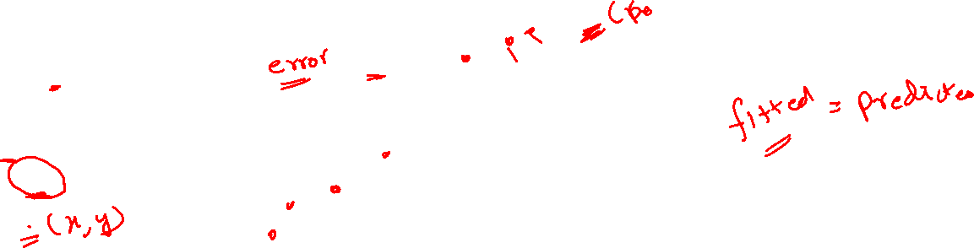

Slide 54
Goodness of Fit – R Square (how good is our Model)
Notes:
Why Mean is used ?
If no algorithm was used the Mean would give us the best predictions. We are find a equation that can give us results better than the mean.
What is Goodness-Of-Fit
The goodness of fit test is a statistical hypothesis test to see how well sample data fit a distribution from a population with a normal distribution. In other words, it tells you if your sample data represents the data you would expect to find in the actual population
What is R-Squared?
For the same data set, higher R-squared values represent smaller differences between the observed data and the fitted values (predicted values). R-squared is the percentage of the dependent variable variation that a linear model explains
Explain R-Square?
R-Squared (R² or the coefficient of determination) is a statistical measure in a regression model that determines the proportion of variance in the dependent variable (predicted variable) that can be explained by the independent variable. ... In other words, r-squared tells how well the data fit the regression model (the goodness of fit).

Slide 55
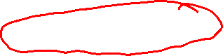
Goodness of Fit – R Square (how good is our Model)
Predicted (ŷ-ȳ)^2 4961.07
Actual (y-ȳ)^2 5226.22
Notes:
Why Mean is used ?
If no algorithm was used the Mean would give us the best predictions. We are find a equation that can give us results better than the mean.
What is Goodness-Of-Fit
The goodness of fit test is a statistical hypothesis test to see how well sample data fit a distribution from a population with a normal distribution. In other words, it tells you if your sample data represents the data you would expect to find in the actual population
What is R-Squared?
For the same data set, higher R-squared values represent smaller differences between the observed data and the fitted values (predicted values). R-squared is the percentage of the dependent variable variation that a linear model explains
Explain R-Square?
R-Squared (R² or the coefficient of determination) is a statistical measure in a regression model that determines the proportion of variance in the dependent variable (predicted variable) that can be explained by the independent variable. ... In other words, r-squared tells how well the data fit the regression model (the goodness of fit).

Slide 56
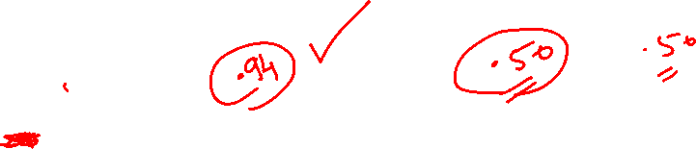
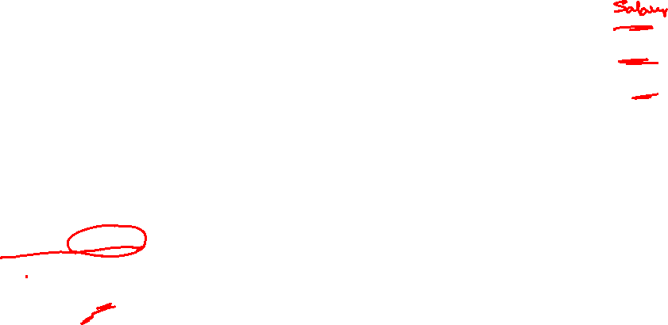
Goodness of Fit – R Square (how good is our Model)
Predicted (ŷ-ȳ)^2 4961.07
Actual (y-ȳ)^2 5226.22
R Square 0.949265435
Notes:
Why Mean is used ?
If no algorithm was used the Mean would give us the best predictions. We are find a equation that can give us results better than the mean.
What is Goodness-Of-Fit
The goodness of fit test is a statistical hypothesis test to see how well sample data fit a distribution from a population with a normal distribution. In other words, it tells you if your sample data represents the data you would expect to find in the actual population
What is R-Squared?
For the same data set, higher R-squared values represent smaller differences between the observed data and the fitted values (predicted values). R-squared is the percentage of the dependent variable variation that a linear model explains
Explain R-Square?
R-Squared (R² or the coefficient of determination) is a statistical measure in a regression model that determines the proportion of variance in the dependent variable (predicted variable) that can be explained by the independent variable. ... In other words, r-squared tells how well the data fit the regression model (the goodness of fit).

Slide 57
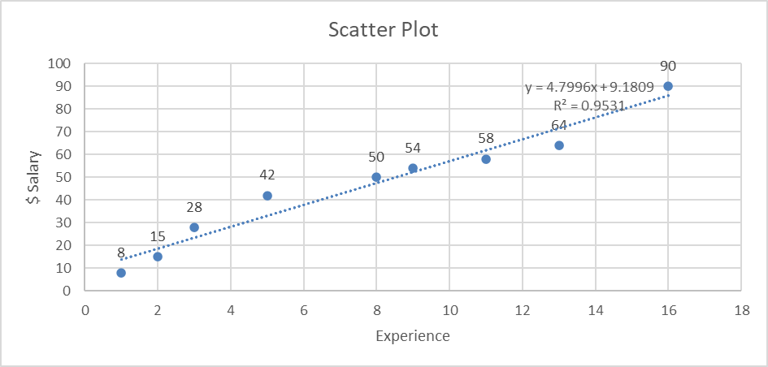
Goodness of Fit – R Square (how good is our Model)
Predicted (ŷ-ȳ)^2 4961.07
Actual (y-ȳ)^2 5226.22
R Square 0.949265435
Notes:
Why Mean is used ?
If no algorithm was used the Mean would give us the best predictions. We are find a equation that can give us results better than the mean.
What is Goodness-Of-Fit
The goodness of fit test is a statistical hypothesis test to see how well sample data fit a distribution from a population with a normal distribution. In other words, it tells you if your sample data represents the data you would expect to find in the actual population
What is R-Squared?
For the same data set, higher R-squared values represent smaller differences between the observed data and the fitted values (predicted values). R-squared is the percentage of the dependent variable variation that a linear model explains
Explain R-Square?
R-Squared (R² or the coefficient of determination) is a statistical measure in a regression model that determines the proportion of variance in the dependent variable (predicted variable) that can be explained by the independent variable. ... In other words, r-squared tells how well the data fit the regression model (the goodness of fit).

Slide 58
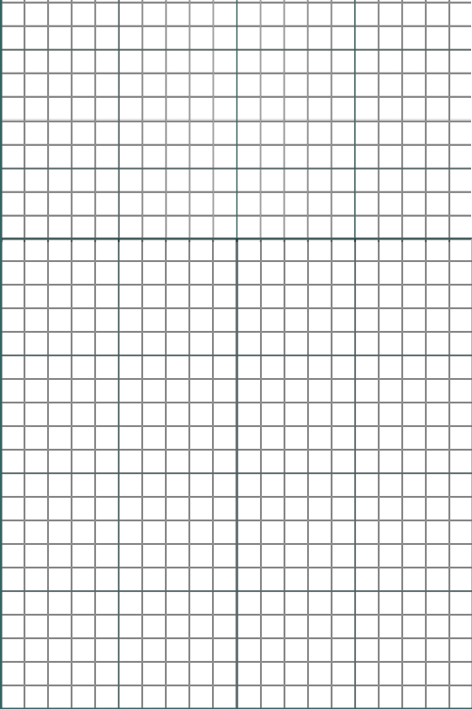
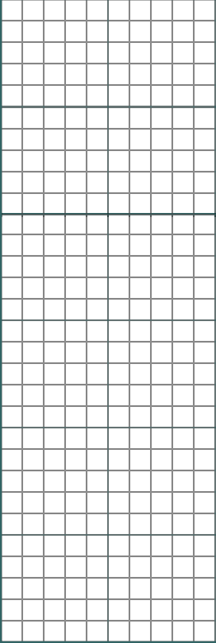
Examples of Better Regression – Better R Square
Actual vs Predicted Value
Y
Dependent
Variable
5
4
L ine of Regression
𝑅² ≈ .19
3
2
1
X
Independent
Variable
Notes:
Another Linear Equation line that is passing through the data points.
A model with R square of > .6
A model should have a R- Square Score of more than> .8

Slide 59

Examples of Better Regression – Better R Square
Actual vs Predicted Value
Y
Dependent
Variable
5
𝑅² ≈ 0.9
4
L ine of Regression
3
2
1
X
Independent
Variable
Notes:
Another Linear Equation line that is passing through the data points.
A model with R square of > .6
A model should have a R- Square Score of more than> .8

Slide 60

Examples of Better Regression – Better R Square
Actual vs Predicted Value
Y
Dependent Variable
5
𝑅² ≈ 1
4
L ine of Regression
3
2
1
Independent
Variable
0
2
4
X
5 6
1
3

Slide 61
9 pm EST, Tuesday 12 November 2024 Big Data, Hadoop Ecosystem, Analytics, Boston Housing Price

Slide 62
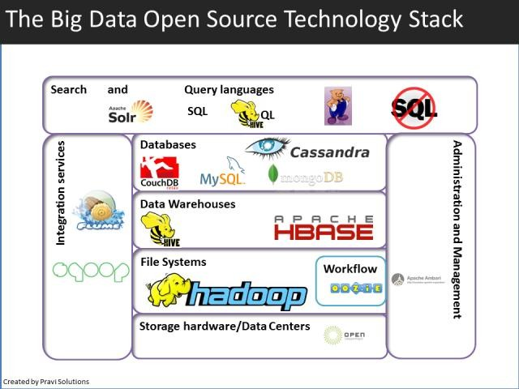

Slide 63


Slide 64
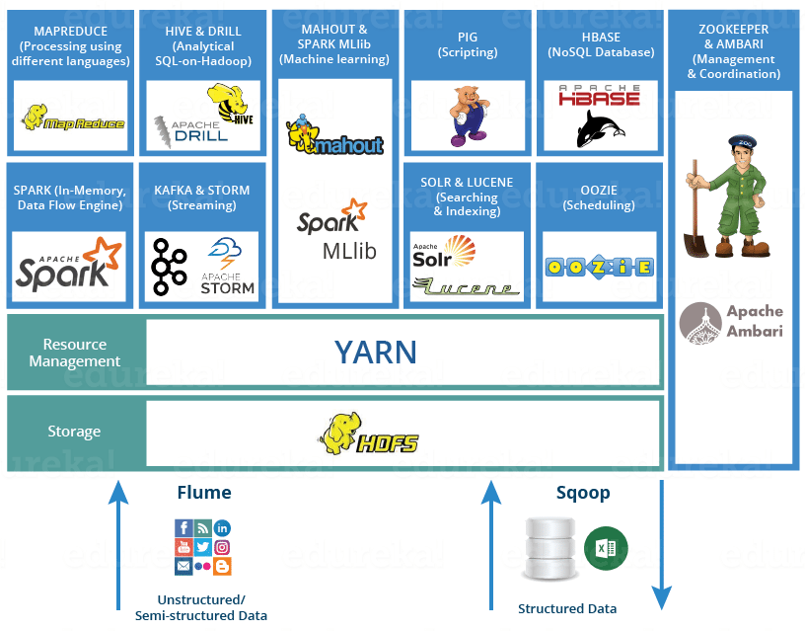
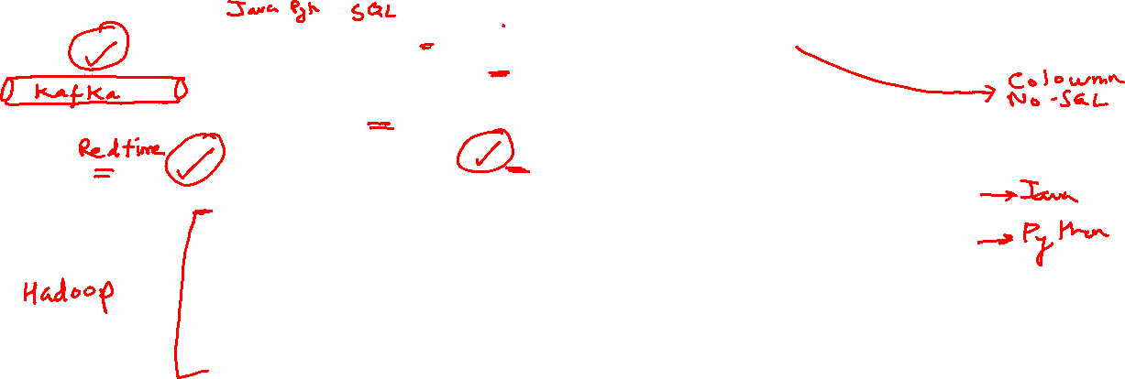

Slide 65
9 pm EST, Wednesday 13 November 2024 Boston Housing Price

Slide 66



Slide 67




Slide 69


Slide 70
9 pm EST, Thursday 14 November 2024

Slide 71
Assignment for 14 November: 1)Run the BOSTON HOUSING PRICING and Explain 2)How to improve the model

Slide 72


Slide 73


Slide 74


Slide 75


Slide 76


Slide 77




Slide 78


Slide 79


Slide 81


Slide 82


Slide 83


Slide 84
Adjusted R-Square
A problem with R-Squared is that if you keep adding more and more independent variables, R-Squared will go up. However, that does not mean these additional variables have a predictive quality. For example, let’s say you are creating a model to predict the weight of a person using their height. You then decide to add the variable, eye color and find that your R-Squared goes up. Does this mean that someone with brown eyes is likely to weigh more or less than someone with blue eyes? Probably not but in order to confirm this we could use Adjusted R-Squared.

Slide 85

Adjusted R-Square
Adjusted R-Squared takes into account the number of independent variables you employ in your model and can help indicate if a variable is useless or not. The more variables you add to your model without predictive quality the lower your Adjusted R-Squared will be. You can see that the number of independent variables, k, is included in the Adjusted R-Squared formula below.

Slide 86

Adjusted R-Square

Slide 87
Predict the Salary Using Experience using Python
Use the Salary and Income data set and python to build the model

Slide 88

Homoscedasticity vs Heteroscedasticity

Slide 89

Homoscedasticity vs Heteroscedasticity:

Slide 90
Homoscedasticity vs Heteroscedasticity
1. Error has zero mean
2. Error has constant variance(Homoscedasticity , the violation of this rule is Heteroscedasticity. )
3. Errors are uncorrelated
4. Errors are normally distributed

Slide 91
Thank you
arunkg99@gmail.com
www.doitskills.com

